Slide 1
An open-source toolkit for mining Wikipedia
Presented by: Hongfei Hu
12/23/2015

Slide 2
Content
Introduction and Background
Architecture
The Wikipedia Mining Toolkit
Basic process
Measuring Relatedness
Annotation

Slide 3
Paper Information
Title: An open-source toolkit for mining Wikipedia
Authors: David Milne, Ian H. Witten
Date: Available online 13 August 2012
Keywords: Wikipedia, Toolkit, Ontology extraction, Semantic relatedness, Disambiguation, Annotation

Slide 4
Introduction and Background
Wikipedia: a vast, constantly tapestry of richly textual information
Two options to mine:
Base work on secondary structures, such as Freebase and Yago => obsolete knowledge
Build your own algorithms directly => time consuming and difficult
Third option:
Share algorithms and code => Wikipedia Miner

Slide 5
Terminology
Article = Topic = Concept
Term = Label

Slide 6
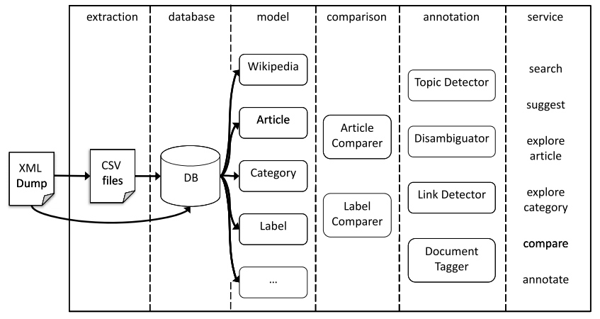
Architecture

Slide 7
The Wikipedia Mining Toolkit
Extraction
Storage, indexing and caching
Modeling
Comparison
Annotation
Service

Slide 8
The Wikipedia Mining Toolkit
Extraction
Storage, indexing and caching
Modeling
Comparison
Annotation
Service
1. Hadoop, A open-source implementation of Google’s proprietary GFS file system
2. MapReduce technology
Database package: Persistent, appropriately indexed access to the summarized data
Notes:
Extraction: no too much detail since the toolkit has exploited Hadoop, a open-source implementation of Google’s proprietary GFS file system.
Also exploited MapReduce technology.
Combine => powerful platform for big data
The database package provides persistent, appropriately indexed access to the summarized data and original markup. Users interact with the database via the model package that wraps it

Slide 9
The Wikipedia Mining Toolkit
Extraction
Storage, indexing and caching
Modeling
Comparison
Annotation
Service

Slide 10
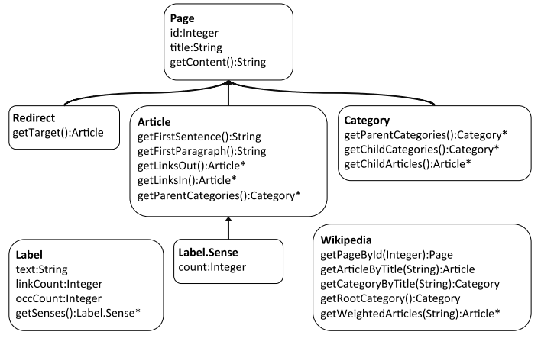
Modeling

Slide 11

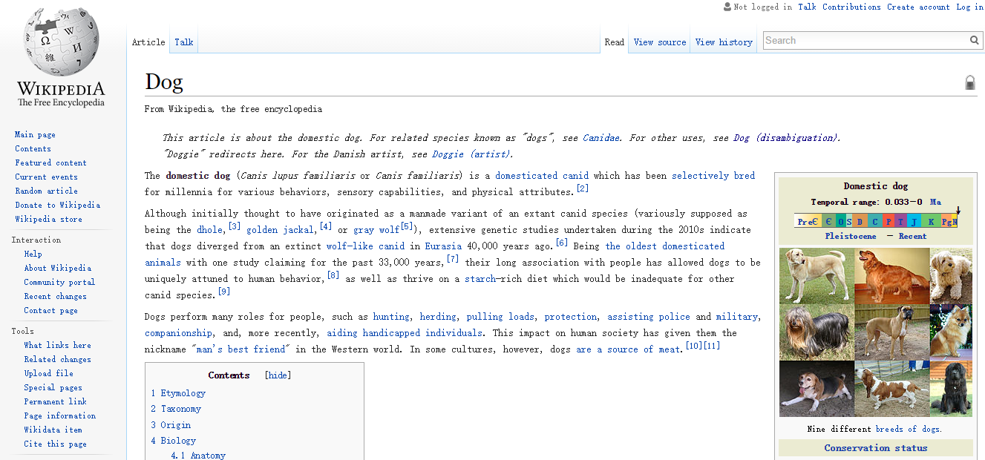

Redirect
Article
Category

Slide 12
Modeling - labels
Article titles, redirects and link anchors are all combined in the toolkit as Labels.
Prior probabilities – useful when disambiguation
76% of dog labels refer to the pet
7% to the Chinese star sign
less than 1% to hot dogs

Slide 13
The Wikipedia Mining Toolkit
Extraction
Storage, indexing and caching
Modeling
Comparison
Annotation
Service

Slide 14
Measuring Relatedness
pet
mammal
color
dog
inch
domestication
chihuahua
dog
breed

Slide 15
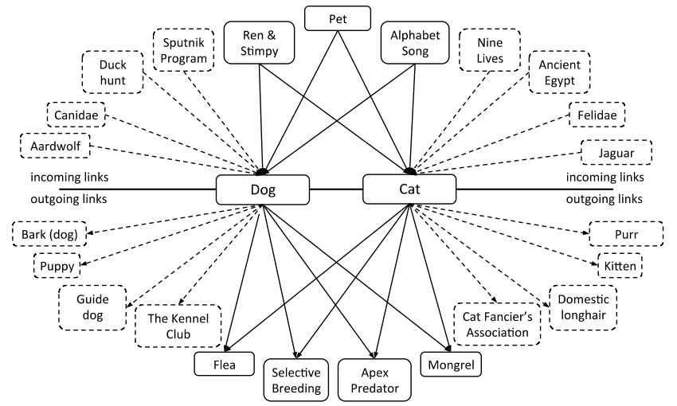
Measuring Relatedness

Slide 16



Measuring Relatedness - features
Intersection size
Union size
Normalized link distance
Link vector similarity
link frequency (lf)
inverse article frequency (iaf)
Direct
Notes:
Extreme example
numerator

Slide 17
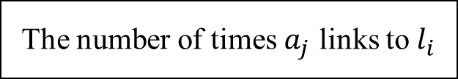
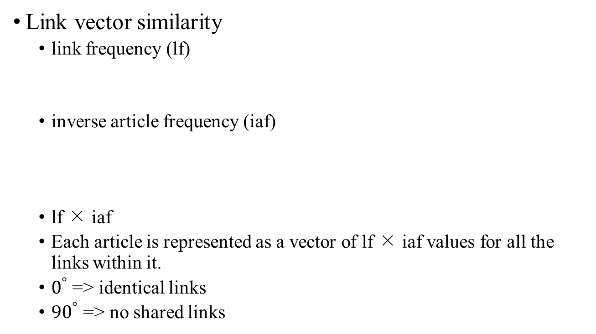
Measuring Relatedness - features
The number of times $a_{j}$ links to $l_{i}$
Link vector similarity
link frequency (lf)
inverse article frequency (iaf)
lf × iaf
Each article is represented as a vector of lf × iaf values for all the links within it.
$0^{°}$ => identical links
${90}^{°}$ => no shared links

Slide 18
Quiz 1
Suppose there is some article like this:
Dog
111111111111122
A
Fdfdfdf
B
B
aaaaa
Cat
111111111111122
A
A
aaaaa
i j | Dog | Cat
A
B
1/3 2/2
2/3 0/2

Slide 19
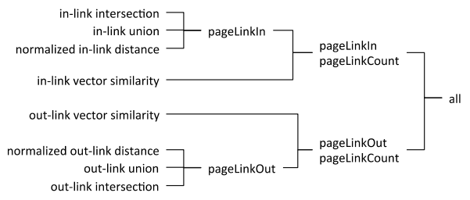
Measuring Relatedness - features

Slide 20
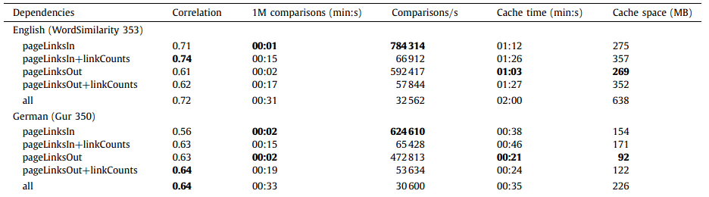
Measuring Relatedness - Training and evaluation
Example: pageLinksIn: in-link intersection, in-link union, and normalized in-link distance features

Slide 21
Quiz 2
Please find the correspondent feature. (and explain why)
Link vector similarity in-links
Normalized link distance out-links

Slide 22
The Wikipedia Mining Toolkit
Extraction
Storage, indexing and caching
Modeling
Comparison
Annotation
Service

Slide 23
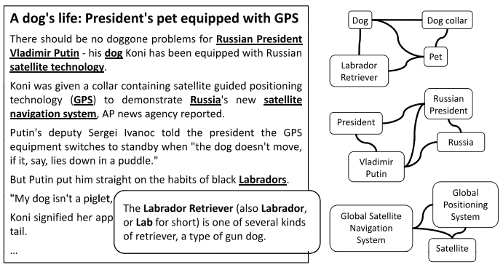
Understanding and augmenting documents

Slide 24
Understanding and augmenting documents
Disambiguation: determining a link’s destination
Detection: deciding whether a link should be made at all

Slide 25
Understanding and augmenting documents - disambiguation
gathering overlapping word n-grams (n: 1 to max length of label)
to ascertain which terms and phrases correspond to concepts in Wikipedia
selecting a single most-appropriate article to represent each label
Features:
Prior probability
Relatedness
Quality of context

Slide 26
Understanding and augmenting documents - detection
Questionable: separate topics that are central to the document from those that are mentioned only in passing.
Dog or hot dog?
Features:
prior link probabilities
disambiguation confidence
weighted average relatedness to context

Slide 27
Quiz 3
Please explain the difference between disambiguation and detection.
You can use any word as an example. (Or just use “Dog”)

Slide 28
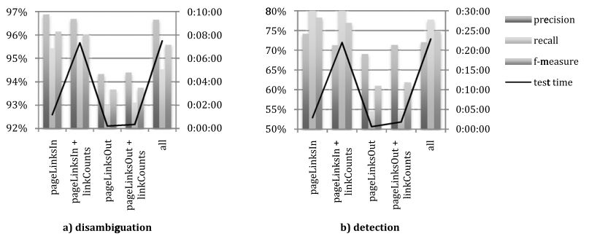
Understanding and augmenting documents - experiment

Slide 29
Downloads
Code, data and online demonstrations of
the Wikipedia-Miner toolkit are available at
http://wikipedia-miner.sourceforge.net

Slide 30
Thanks! Q&A Merry Christmas & Happy Final!

